Slide 1
The Assignment Problem
Thomas Hirsch
March 2021

Slide 2
Introduction
Background
Theory
Managed move tool

Slide 3
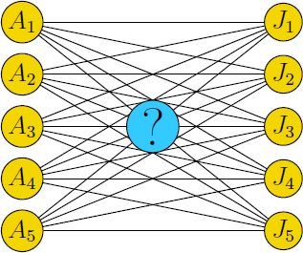
Assignment Problem
The assignment problem deals with assigning machines to positions, workers to jobs etc.
The goal is to determine the optimum assignment that, for example, minimizes the total cost or maximizes the team effectiveness.
A popular algorithm for solving this is the Hungarian Algorithm

Slide 4
Hungarian algorithm
Developed in 1950s by mathematicians Harold Kuhn and James Munkres, building on work by Hungarian mathematicians Dénes Kőnig and Jenő Egerváry
In 2006 it was discovered that German mathematician Carl Gustav Jacobi had solved it much earlier, with the solution published posthumously in 1890 in Latin.
Provides an optimal solution to the assignment problem, in strongly polynomial time with (O³) complexity
 | J1 | J2 | J3 | J4
W1 | 82 | 83 | 69 | 92
W2 | 77 | 37 | 49 | 92
W3 | 11 | 69 | 5 | 86
W4 | 8 | 9 | 98 | 23

Slide 5
Hungarian Algorithm - example
Step 1: remove row minima
Step 3: cover zeroes with fewest lines
 | J1 | J2 | J3 | J4
W1 | 13 | 14 | 0 | 23 | (-69)
W2 | 40 | 0 | 12 | 55 | (-37)
W3 | 6 | 64 | 0 | 81 | (-5)
W4 | 0 | 1 | 90 | 15 | (-8)
 | J1 | J2 | J3 | J4
W1 | 13 | 14 | 0 | 8
W2 | 40 | 0 | 12 | 40
W3 | 6 | 64 | 0 | 66
W4 | 0 | 1 | 90 | 0
Step 2: remove column minima
Step 4: create additional zeroes by subtracting minimum of uncovered and adding to doubly-covered
 | J1 | J2 | J3 | J4
W1 | 13 | 14 | 0 | 8
W2 | 40 | 0 | 12 | 40
W3 | 6 | 64 | 0 | 66
W4 | 0 | 1 | 90 | 0
 |  |  |  | (-15)
 | J1 | J2 | J3 | J4
W1 | 7 | 8 | 0 | 2
W2 | 40 | 0 | 18 | 40
W3 | 0 | 58 | 0 | 60
W4 | 0 | 1 | 96 | 0

Slide 6

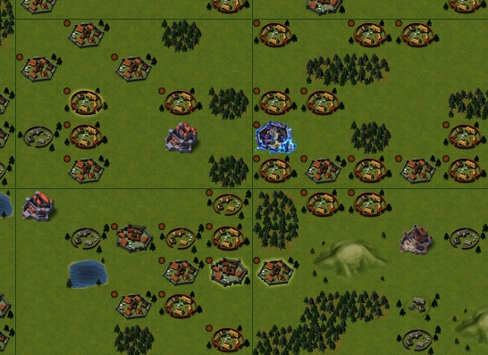
Managed moves
DASD had managed move program to facilitate level transfers within the department (and partnering departments)
Wanted a tool to help allocating applicants to roles according to preferences. Textbook Assignment Problem!
I looked for a VBA implementation online, but eventually translated a C# implementation

Slide 7
Demo
Demo time!

Slide 8
References
http://www.hungarianalgorithm.com/ - simple explanation of the algorithm
https://brc2.com/the-algorithm-workshop/ - source of my tool’s implementation

